Slide 1
NDWI

Slide 2
GREEN - NIR
NDWI =
GREEN + NIR

Slide 3
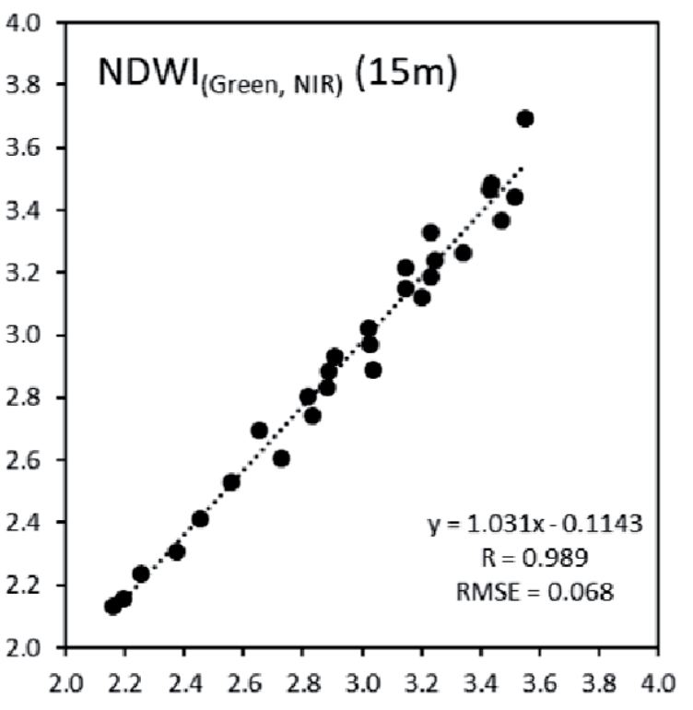
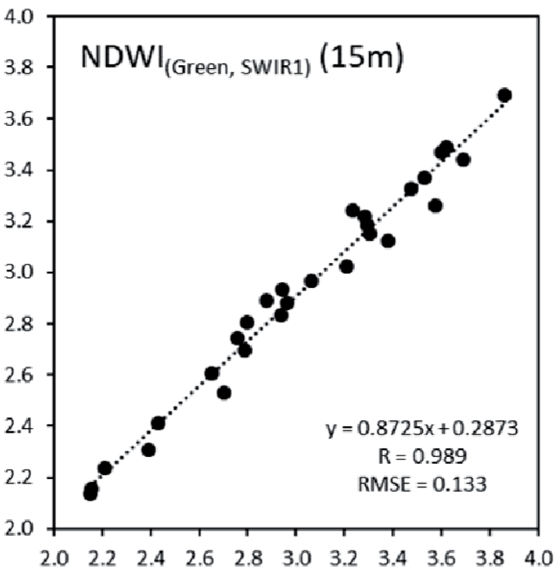
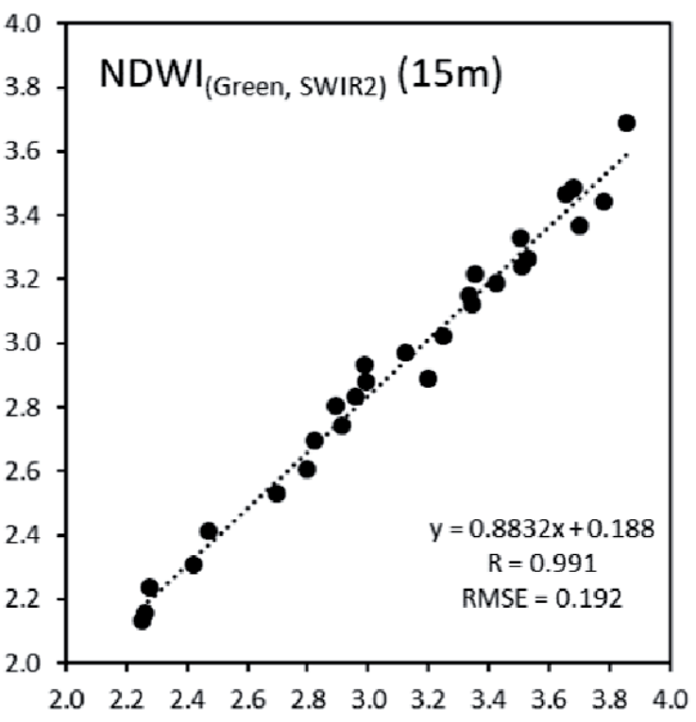
Modified NDWI

Slide 4
NDWI Anomaly
X_{t} - X
NDWI Anomaly =
δ

